Slide 1
DBMS
Database Schema

Slide 2
Database Schema
A database schema is a structure that represents the logical storage of the data in a database.
It represents the organization of data and provides information about the relationships between the tables in a given database. In this topic, we will understand more about database schema and its types. Before understanding database schema, lets first understand what a Database is.

Slide 3
A database schema is the logical representation of a database, which shows how the data is stored logically in the entire database. It contains list of attributes and instruction that informs the database engine that how the data is organized and how the elements are related to each other.
A database schema contains schema objects that may include tables, fields, packages, views, relationships, primary key, foreign key.

Slide 4
In actual, the data is physically stored in files that may be in unstructured form, but to retrieve it and use it, we need to put it in a structured form. To do this, a database schema is used. It provides knowledge about how the data is organized in a database and how it is associated with other data.
The schema does not physically contain the data itself; instead, it gives information about the shape of data and how it can be related to other tables or models.

Slide 5
A database schema object includes the following:
Consistent formatting for all data entries.
Database objects and unique keys for all data entries.
Tables with multiple columns, and each column contains its name and data type.
The complexity & the size of the schema vary as per the size of the project. It helps developers to easily manage and structure the database before coding it.
The given diagram is an example of a database schema. It contains three tables, their data types. This also represents the relationships between the tables and primary keys as well as foreign keys.

Slide 6


Slide 7
Types of Database Schema
The database schema is divided into three types, which are:
Physical Schema
Logical Schema
View Schema

Slide 8
Physical Database Schema
A physical database schema specifies how the data is stored physically on a storage system or disk storage in the form of Files and Indices.
Designing a database at the physical level is called a physical schema.

Slide 9
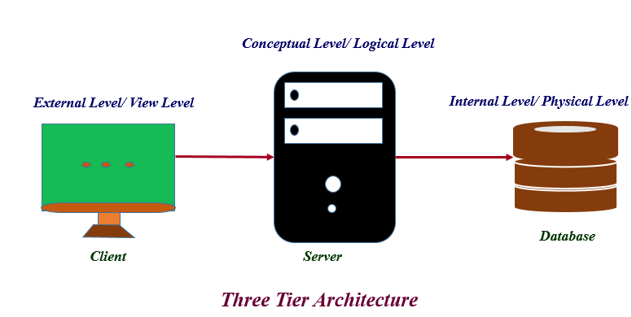

Slide 10
Logical Database Schema
The Logical database schema specifies all the logical constraints that need to be applied to the stored data. It defines the views, integrity constraints, and table. Here the term integrity constraints define the set of rules that are used by DBMS (Database Management System) to maintain the quality for insertion & update the data. The logical schema represents how the data is stored in the form of tables and how the attributes of a table are linked together.

Slide 11
At this level, programmers and administrators work, and the implementation of the data structure is hidden at this level.
Various tools are used to create a logical database schema, and these tools demonstrate the relationships between the component of your data; this process is called ER modeling.
The ER modeling stands for entity-relationship modeling, which specifies the relationships between different entities.
We can understand it with an example of a basic commerce application. Below is the schema diagram, the simple ER model representing the logical flow of transaction in a commerce application.

Slide 12
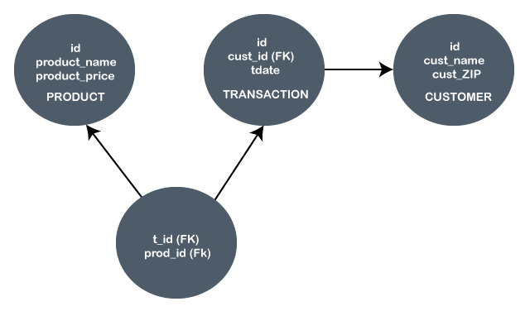

Slide 13
In the given example, the Ids are given in each circle, and these Ids are primary key & foreign keys.
The Primary key is used to uniquely identify the entry in a document or record. The Ids of the upper three circles are the primary keys.
The Foreign key is used as the primary key for other tables. The FK represent the foreign key in the diagram. It relates one table to another table.

Slide 14
View Schema
The view level design of a database is known as View Schema. This schema generally describes the end-user interaction with the database systems.

Slide 15
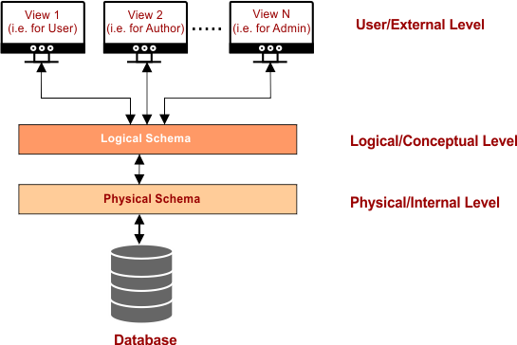

Slide 16
Thank YOU

